Slide 1
User Requirement Specification
Outlet & Distribution House Creation

Slide 2
Outlet Creation
DBH View
Outlet
Create Outlet
Code | Name | Creation Date | Address | Rout | owner Name | Owner Mob. No. | Status
001 | Mahbub General | 05-11-2015 | Mirpur | Mirpur Market |  |  | Active/Inactive Productive/non-productive
002 | Yoha Store | 10-05-2015 | Baridhara | Baridhara Market
Show
100
Entries
Search
CSV Excel PDF
TO create outlet user will click the “Create Outlet “ option. TO will approve the outlet. TO will be notified.

Slide 3
Outlet Information
DBH View
Outlet
Home Outlet Create outlet
Owner/Manager Details :
DBH
System
Name
Route > Sub Rout
Date of Birth
Outlet Code
System Generated(automatic code generation
Contact no.
Outlet Name
English
Bangla
Marriage Day
Channel
Image
Outlet
Outlet Type
Exclusive/ Nonexclusive
Outlet
Geo Location
Visicoolar
Address
English
Bangla
Address
Address
Save
Thana
Thana
District
District
CE will approve newly created outlet.
Outlet Address: Impact will be in invoice only. If there is no Bangla then show only English. In other case need to show both.

Slide 4
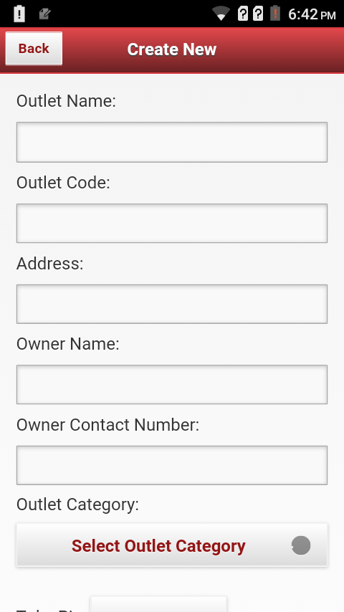
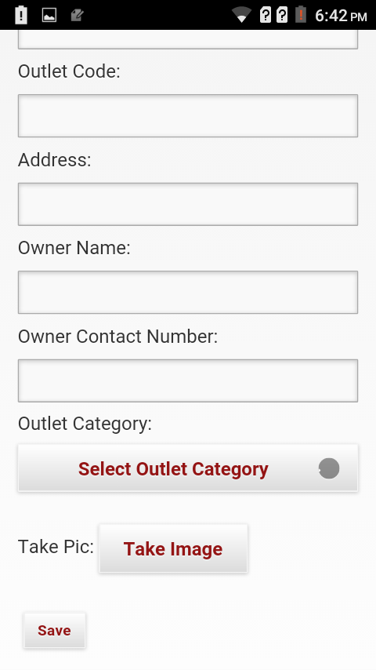
APK View (PSR)
Add on Fields
Channel
Outlet Type
Exclusive/ Nonexclusive
Spoke

Slide 5
Outlet Approvals
Customer Executive View
New Outlets
Code | Name | Created By | Creation Date | Address | Rout | Owner Name | Owner Mob. No. | Collected By | Action
001 | Mahbub General |  | 05-11-2015 | Mirpur | Mirpur Market
002 | Yoha Store |  | 10-05-2015 | Baridhara | Baridhara Market
Show
100
Entries
Search
CSV Excel PDF
Approve
Edit
Delete
Approve
Edit
Delete
CE will approve the outlet.

Slide 6
Distribution House Creation
MIS/operator View
Distribution House
Create Distribution House
Code | Name | Owner | Address | Mobile No. | Creation Date | Status
Show
100
entries
Search
CSV Excel PDF
To create Distribution House user will click the “Create Distribution House “ option. HO will input the code column.
Head(MIS/operator) office will create.

Slide 7
Distribution House Information
Distribution House
Home Outlet Create outlet
Active
Asset List
DB Code
DB Name
SL | Asset Name | Asset market Value | QTY
01 |  |  | Add
02
Creation Date
DB Type
HUB/ Spok/ DBH
Cluster
Metro Town/Power/Urban/Semi urban
Office Address
Ware House Address
W/H Manager name
Contact Number
GEO
Distributor Name
Bank Details
Contact no.
Bank Name
E-mail
Brach Name
Vat Reg. Number
A/C Number
TIN Number
Save

